Slide 1
Connect_4 Game using Swing

Slide 2
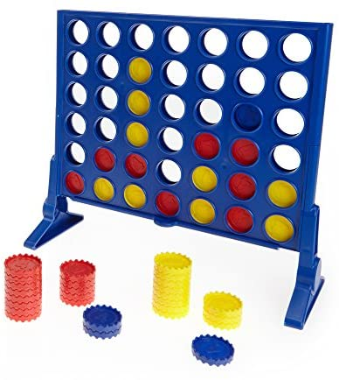
About Connect_4
Connect Four (also known as Four Up, Plot Four, Find Four, Captain's Mistress, Four in a Row, Drop Four, and Gravitrips in the Soviet Union) is a two-player connection board game, in which the players choose a color and then take turns dropping colored discs into a seven-column, six-row vertically suspended grid. The pieces fall straight down, occupying the lowest available space within the column. The objective of the game is to be the first to form a horizontal, vertical, or diagonal line of four of one's own discs. Connect Four is a solved game. The first player can always win by playing the right moves.

Slide 4
Java Swing
Java Swing tutorial is a part of Java Foundation Classes (JFC) that is used to create window-based applications. It is built on the top of AWT (Abstract Windowing Toolkit) API and entirely written in java.
Unlike AWT, Java Swing provides platform-independent and lightweight components.
The javax.swing package provides classes for java swing API such as JButton, JTextField, JTextArea, JRadioButton, JCheckbox, JMenu, JColorChooser etc.

Slide 5
Board of the Gui
public class Board { private int rows; private int columns; Piece [][]ourBoard; public Piece[][] getOurBoard() { return ourBoard; } public int getColumns() { return columns; } public int getRows() { return rows; }

Slide 6
Pieces to Add
public class Piece { private String color; public String getColor() { return color; } public void setColor(String color) { this.color = color; } }

Slide 7
Choosing the player to play first
public Connect4Game(String color1, String color2, int rows, int columns) { this.board = new Board(rows, columns); this.color1 = color1; this.color2 = color2; is1playing = (new Random()).nextBoolean(); }
boolean player1turn = game.isIs1playing(); if(player1turn) setTitle(title + "Yellow"); else setTitle(title + "Red");

Slide 8
The Game Begins
public int round(int col) { String color = is1playing ? color1 : color2; int row = board.addPiece(col, color); if(row != -1) is1playing = !is1playing; return row; }

Slide 9
Checking Possibilities of Winning
private boolean checkDiagonal(int row, int col, String winningColor, boolean rightDiagonal) { int winningStreak = 4; int reverser = rightDiagonal ? 1 : -1; int rows = board.getRows(); int columns = board.getColumns(); Piece[][] ourBoard = board.getOurBoard(); for(int winRow = row - 3, winCol = col - (3 * reverser); winRow <= row + 3; winRow++, winCol += reverser) { if (!rightDiagonal) { if (winRow < 0 || winCol < 0) continue; if (winRow >= rows || winCol >= columns) break; } else { if(winRow < 0 || winCol >= columns) continue; if(winRow >= rows || winCol < 0) break; } if(ourBoard[winRow][winCol] != null && ourBoard[winRow][winCol].getColor().equals(winningColor)) { if (--winningStreak == 0) return true; } else winningStreak = 4; } return false;

Slide 10
Checking Possibilities of Winning
winningStreak = 4; // look at the horizontal for(int winCol = col - 3; winCol <= col + 3; winCol++) { if(winCol < 0) continue; if(winCol >= columns) break; if(ourBoard[row][winCol] != null && ourBoard[row][winCol].getColor().equals(winningColor)) { winningStreak--; if(winningStreak == 0) return true; } else winningStreak = 4; } if(checkDiagonal(row, col, winningColor, false)) return true; if(checkDiagonal(row, col, winningColor, true)) return true; return false; } } return false; }
public boolean checkForWinner(int col, String winningColor) { int rows = board.getRows(); int columns = board.getColumns(); Piece[][] ourBoard = board.getOurBoard(); for(int row = 0; row < rows; row++) { if(ourBoard[row][col] != null) { // if this reaches 0, we have won int winningStreak = 3; // check downwards for(int winRow = row + 1; winRow < rows; winRow++) { if(ourBoard[winRow][col].getColor().equals(winningColor)) { winningStreak--; if(winningStreak == 0) return true; } else winningStreak = 3; }

Slide 11
Setting Images for Frame
public GUI(boolean player1turn, Connect4Game game, int rows, int columns) { this.game = game; this.rows = rows; this.columns = columns; // Prepare Icons // Image path relative to the project root (i.e., bin) String imgEmptyFilename = "images/empty.png"; URL imgURL = getClass().getClassLoader().getResource(imgEmptyFilename); if (imgURL != null) iconEmpty = new ImageIcon(imgURL); else System.err.println("Couldn't find file: " + imgEmptyFilename); String imgRedFilename = "images/red.png"; imgURL = getClass().getClassLoader().getResource(imgRedFilename); if (imgURL != null) iconRed = new ImageIcon(imgURL); else System.err.println("Couldn't find file: " + imgRedFilename); String imgYellowFilename = "images/yellow.png"; imgURL = getClass().getClassLoader().getResource(imgYellowFilename); if (imgURL != null) iconYellow = new ImageIcon(imgURL); else System.err.println("Couldn't find file: " + imgYellowFilename); cp = getContentPane(); //Returns the contentPane object for this frame. cp.setLayout(new FlowLayout(FlowLayout.CENTER, 0, 0)); //Sets the layout manager for this container.

Slide 12
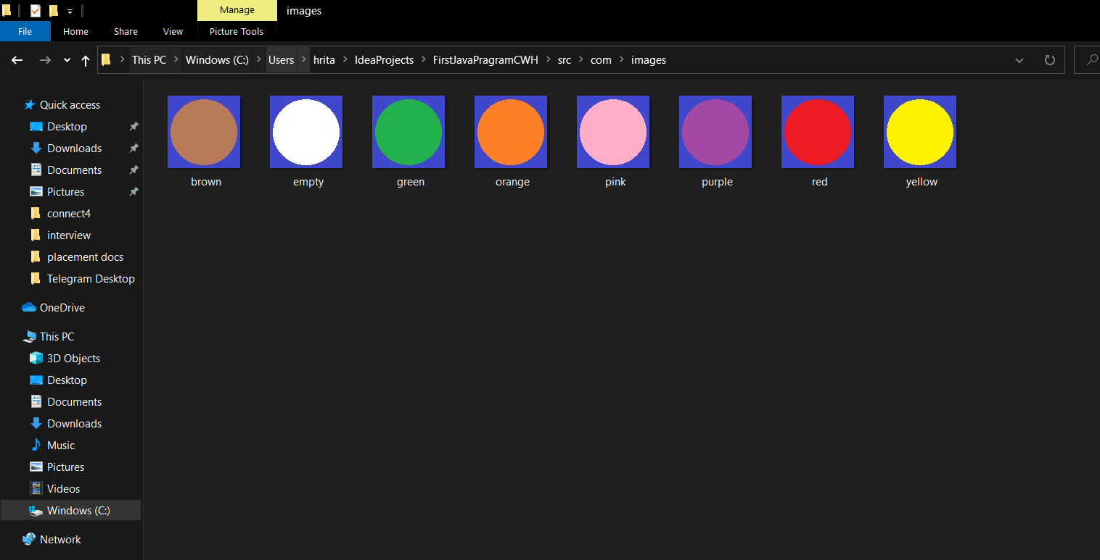

Slide 13
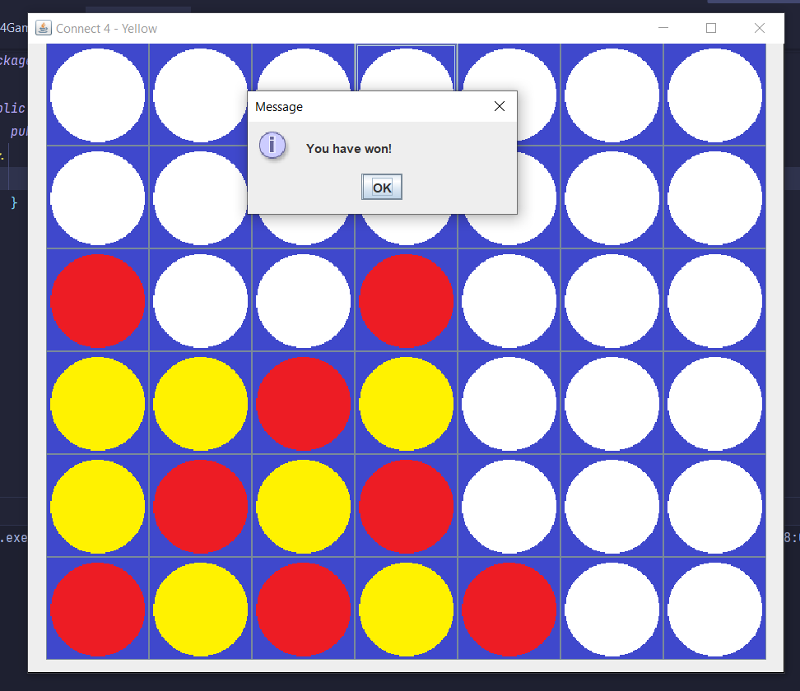
Checks for Winner
// check for winner if(game.checkForWinnerInGUI(col)) { JOptionPane.showMessageDialog(null, "You have won!"); int reply = JOptionPane.showConfirmDialog(null, "Would you like to play again?", null, JOptionPane.YES_NO_OPTION); if(reply == JOptionPane.YES_OPTION) { System.out.println("Trying to play again..."); game.reset(6, 7); resetBoard(); } else { System.exit(0); } } } else { JOptionPane.showMessageDialog(null, "Please select a valid position."); }

Slide 14
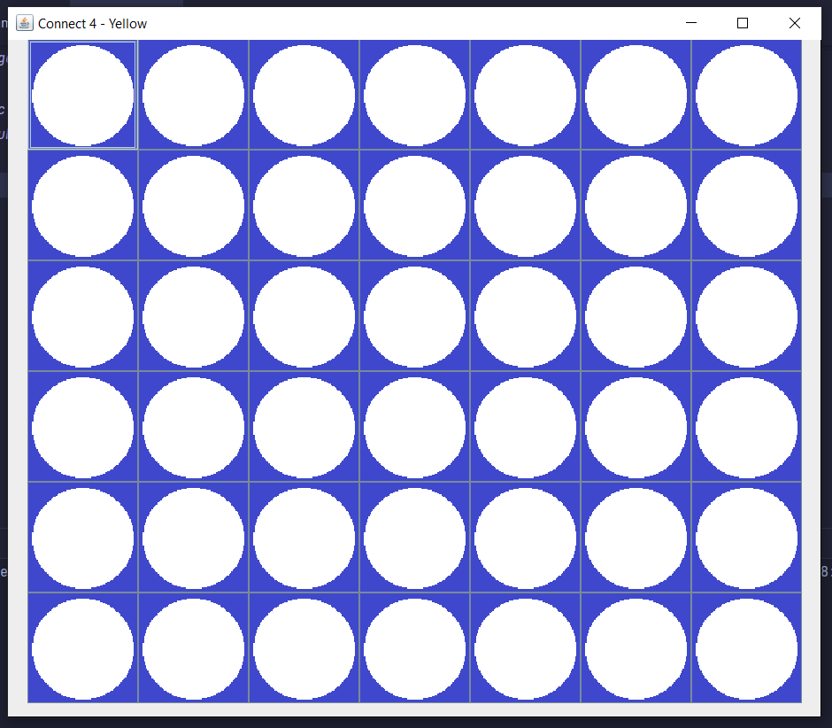
Reset the Game
public void reset(int rows, int columns) { this.board = new Board(rows, columns); is1playing = (new Random()).nextBoolean(); }
public void resetBoard() { for(int row = 0; row < rows; row++) for (int col = 0; col < columns; col++) ((JButton)(cp.getComponent(columns * row + col))).setIcon(iconEmpty); }

Slide 15
Thanks!
Any questions? You can find me at:
@username
user@mail.me

